Slide 1
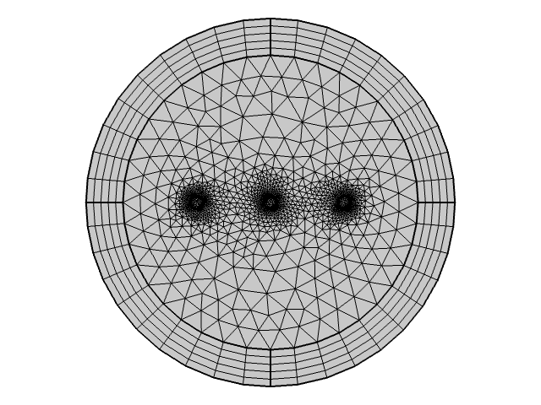
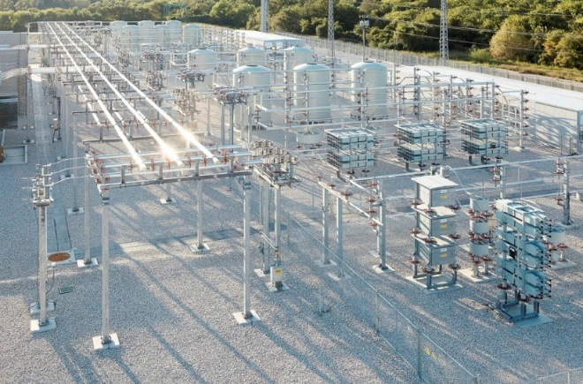
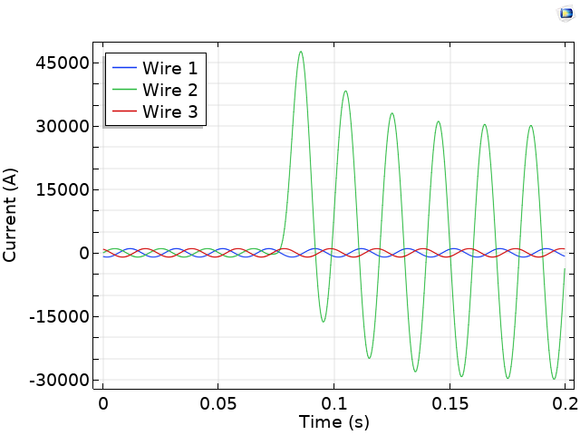
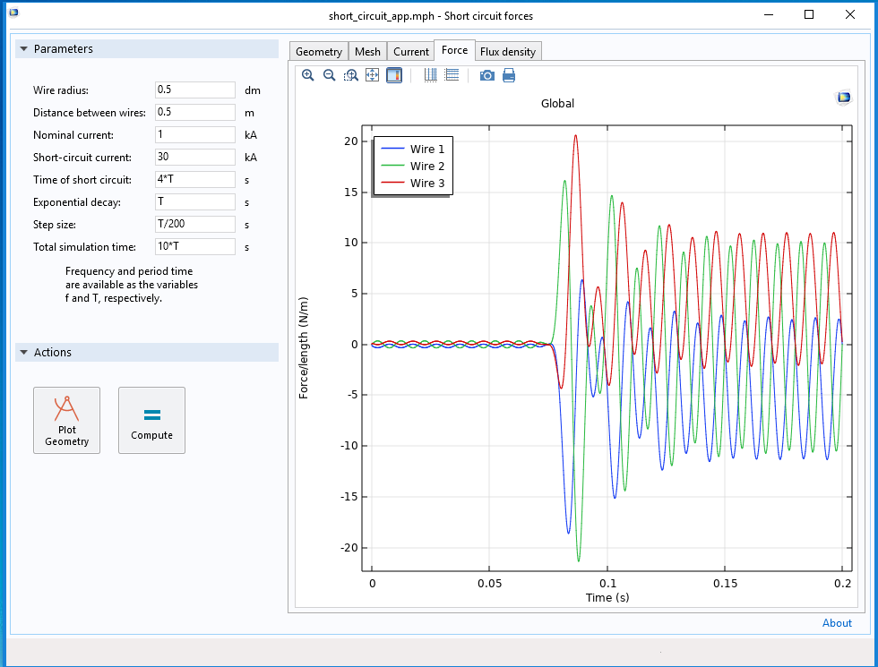
Forces on parallel three-phase AC-conductors during a phase to ground fault
Daniel Edström¹, Nils Lavesson², Magnus Ögren¹
¹School of Science and Technology, Örebro University, Sweden ²ABB Corporate Research, Västerås, Sweden
INTRODUCTION: We calculate forces on parallel AC conductors, as is present in various electrical installations e.g. in substations [1], see an example in Fig. 1. Including the skin effect due to the AC-currents and the relatively large cross sections, forces on each of the conductors are calculated and studied as function of the geometry for a phase to ground fault.
RESULTS: After stepwise numerical benchmarking, reported in the conference paper, we finally create a Simulation App for calculating forces on the conductors [3] during a non-trivial short circuit event.
Figure 3. Example mesh for a cross section of the AC-conductors, Fig. 1.
Figure 1. An ABB static var compensator outside Dallas, US. The three conductors to the left motivates the geometry considered (Fig. 3). Picture by ABB.
THEORY: AC produce alternating magnetic fields which induces eddy currents in the conductor. As a result the majority of charge transport occurs close to the surface of the conductor (Fig. 2). This is known as the skin effect.
Figure 4. Currents applied to the three wires.
Figure 2. Normalized current densities for AC of different frequencies, top line for f=0 (DC), lowest curve is for f=1.0 kHz. Dashed curves are from analytic formulae [2], while circles shows results from Comsol.
A phase to ground fault is simulated with the Magnetic Fields interface of COMSOL Multiphysics using a 2D cross-section of the wires and the surrounding air (Fig. 3). The governing equations are those of Ampère’s Law:
$$∇×H=J, B= ∇×A, J=σE$$
The simulated currents are shown in Fig. 4 and the forces between the wires are calculated by integrating the Maxwell surface stress tensor.
Figure 5. Simulation App for the electric power industry showing the calculated forces.
CONCLUSIONS: Forces on conductors in a sub- station during a phase to ground fault can be calculated in a time dependent study with the AC/DC Module. Finally, we have created a Simulation App for the electric power industry.
REFERENCES:
IEEE Standard C37.12-2008 - IEEE Guide for Bus Design in Air Insulated Substations.
Jordan, Edward Conrad (1968), Electromagnetic Waves and Radiating Systems, Prentice Hall, ISBN 978-0-13-249995-8.
www.comsol.se/model/electromagnetic-forces-on-parallel-current-carrying-wires-131
Excerpt from the Proceedings of the 2019 COMSOL Conference in Cambridge

