Slide 1
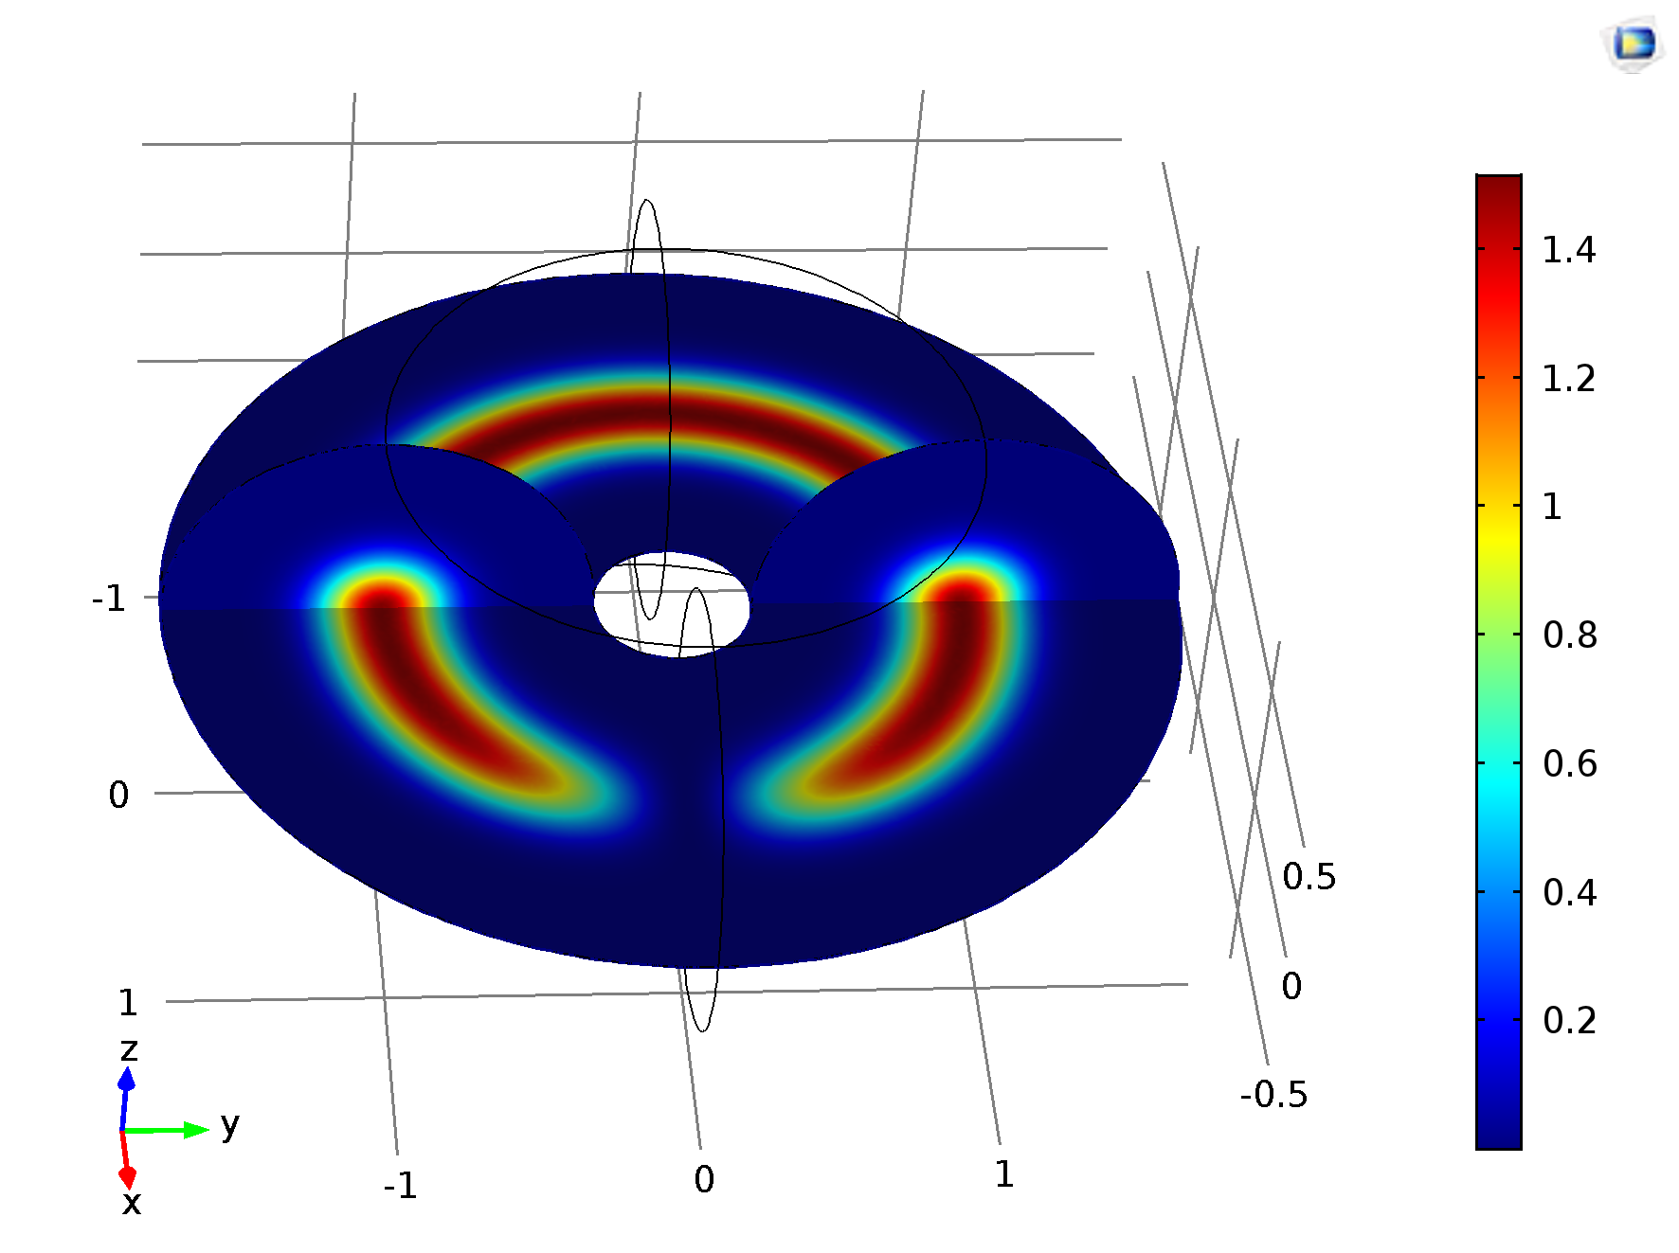
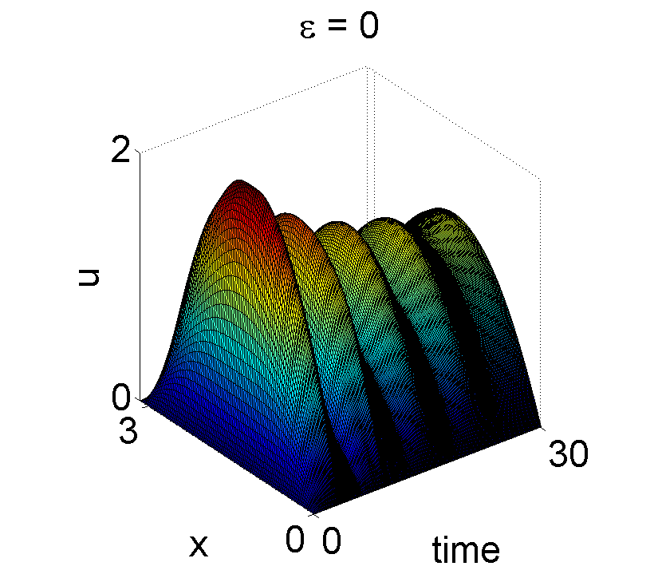
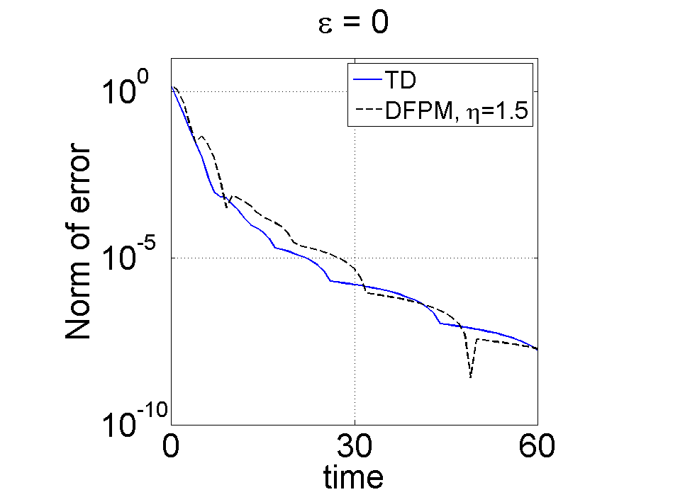
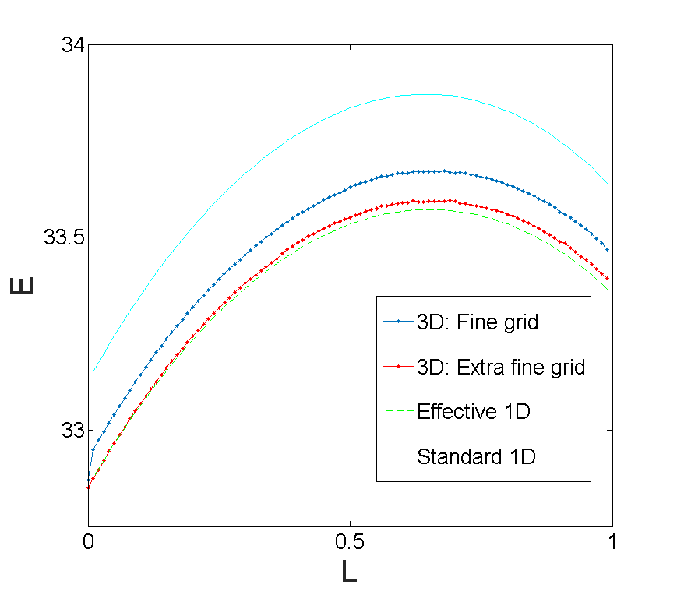
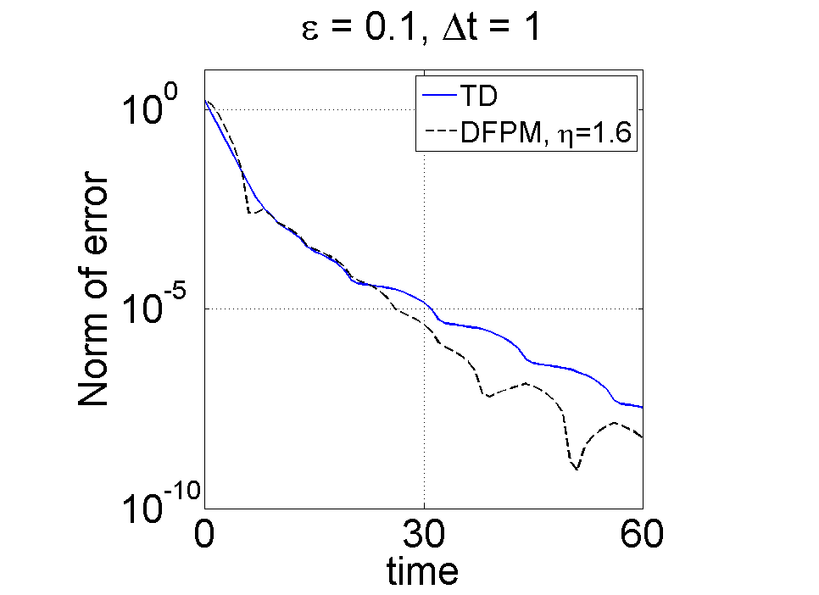
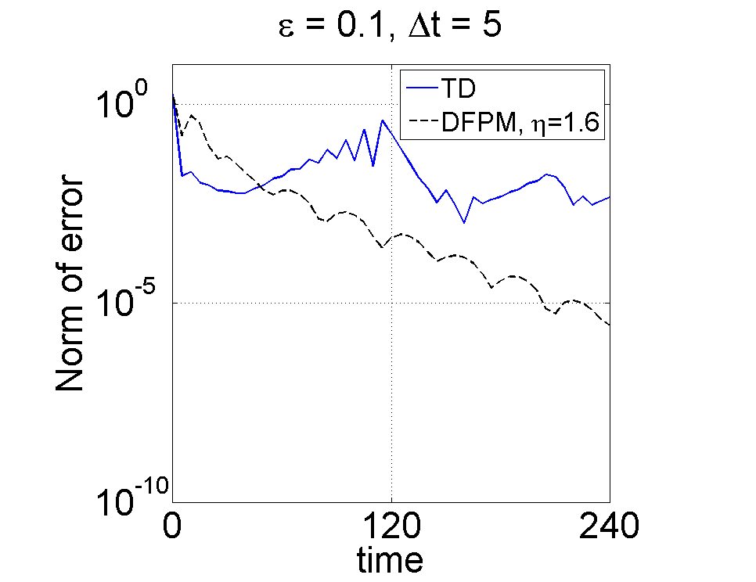
Finding Stationary Solutions with Constraints using Damped Dynamical Systems P. Sandin, A. Lockby, M. Ögren and M. Gulliksson Örebro University School of Science and Technology, S-70182 Örebro, Sweden
Motivation
It is generally challenging to find solutions to non-linear equations. Comsol built-in stationary solvers sometimes fails and also require good initial guesses. Yet, this situation occurs in multiple applications in science and technology. Adding constraints on the solution implies further difficulties for numerical methods.
Constraints
The DFPM can be used for additional constraints, $G_{j}\left(u\right)=0,$
where λ_{j} are Lagrange multiplicators and
are defined by the functional derivative of a constraint functional [3].
Non-linear Schrödinger Equation (NLSE)
In modern physics, the stationary NLSE may have the form
for the complex wavefunction $φ$. Which is constrained by the normalization condition
where $Nφ$ is the number of atoms, $M$is the mass of an atom, and the atom-atom mean field interaction parameter $U_{0}$ can be varied in sign and amplitude. We recently solved this problem with DFPM for a ring geometry [3].
The Dynamical Functional Particle Method (DFPM)
Consider the abstract equation for an unknown $v$, $\min_{v}{E\left(v\right),}$
We introduce a parameter Ƭ and define a new time dependent differential equation, such that $u$ → $v$ when Ƭ → $∞$,
We recognize a second-order damped system where $η$ represents the damping. However, the method is suitable for problems far from this mechanical analogue [1].
Stationary Solutions to the Heat Equation
We consider heat transport, including non-linear source terms
With Dirichlet boundary conditions and the physical parameters set to unity, we study the following Time Dependent (TD) dimensionless, non-linear equation in terms of stationary solutions,
The linear ($ε=0$) problem have a simple analytic stationary solution. We then ($ε≠0$) compare with the built-in stationary solvers in Comsol [2]. Applying the DFPM we have
Convergence to the Stationary Solutions
Future Work
In an ongoing project we use Comsol to investigate more realistic geometries [4].
Example of a dark soliton
in a torus-shaped 3D
Bose-Einstein condensate (BEC).
The energy, E, of the BEC, given a
normalization constraint and
an additional constraint on the
angular momentum, L.
Can we implement DFPM efficiently in Comsol to find stationary solutions with constraints?
References
[1] S. Edvardsson, M. Gulliksson and J. Persson, J. Appl. Mech. 79, 021012 (2012). [2] www.comsol.com. We are using Comsol 5.2. [3] P. Sandin, M. Ögren and M. Gulliksson, Phys. Rev. E 93, 033301 (2016). [4] P. Sandin, Dimensional reduction in Bose-Einstein condensed clouds of atoms in tight potentials of any geometry and any interaction strength, to be submitted.

